Slide 1
WEB STACK PROJECT
T-Une
Presented by:
Adhish Bahl(2347203)
Ansh Bhandari(2347212)
Shivanshi Singh(2347254)

Slide 2
Content Slide
S.No. | Title
1. | Abstract
2. | Introduction
3. | H/w and S/w requirements
4. | Project description ( modules )
5. | Conclusion
6. | Screenshots

Slide 3
Abstract
The T-Une website is a comprehensive platform designed for music enthusiasts, offering a wide range of features and services. It serves as a one-stop solution for users to access music-related news, explore various music genres, connect with like-minded individuals, and stay up-to-date with their favorite artists. Additionally, users can shop for subscriptions to different music streaming platforms and purchase merchandise. Inspired by the navigation style of BuzzFeed, the website aims to provide an engaging user experience with features like liking, sharing, and interactive quizzes. Overall, T-Une is a hub for music lovers, combining entertainment and convenience in the digital music world.

Slide 4
Introduction
The music industry makes up a large part of the entertainment world today. From new albums dropping every single day to keeping up to date with the most trending tracks and the controversies that come along with it. The T-Une is a one stop platform for all the music lovers that want to be ahead of the game.
With the help of our website, be the first to hear the latest news about your favourite artist, connect directly with fellow fans in the community. The website provides features such a liking and sharing of the posts. Users can learn new facts about the artists and take up quizzes to know how well they know them.
The website not only serves the purpose of entertainment but also provides a provision to purchase albums and merchandise of different artists.
Navigation through the website is inspired by that of BuzzFeed. Engagement with the users will take place through posts and feedback section.

Slide 5
Hardware Requirements for T-Une
RAM: Minimum 4GB RAM
Processor: Dual-core or higher
Storage: SSD recommended for faster performance
Internet Connection: Stable broadband connection for streaming and updates
Display: Standard computer screen
Software Requirements for T-Une
Web Browser (e.g., Chrome, Firefox, Safari)
Operating System (e.g., Windows)
React.js (Front-end Framework)
Database System (for storing user data and preferences)

Slide 6
Modules
Login: Users can sign up when they visit the website for the first time, once they have signed in then they can login the website by entering their email id and password.
Selecting Preference: When user sign in for the first time in the website then they will be asked their preferred genres so that we can give them a customised feed. They don’t need to select their preference after that. We will store their preference.
User Information: User Information is stored in the database. Password of the user will not be stored without encryption, we will first encrypt the password then it will be stored in the database. All sensitive information will be encrypted.
Home Page: On the home page users will get to see the news from their preferred genres. Only small summary of the news will be visible, to view the whole news, users can click on the news. Users can also share and like the news if they want to.

Slide 7
5. Quizzes: If the users want then they can take up quizzers that will be based on their preferred genres.
6. Explore: If the users don’t want to limit to their preferred genres, then users can go to explore page to read the news from all the genres.
7. Shopping: Users can shop different merchandise and different music streaming platform subscription from our website. We will list their prices and we will rate them as well.
8. Feedback: Users can give us the feedback about their experience with our website. How is the interface, how useful the news are and lot more.

Slide 8
CONCLUSION
In summary, T-Une aims to not only provide an exceptional music listening experience but also to impact the music industry positively by supporting artists, promoting music discovery, and creating a vibrant music community. Its success is measured by user engagement, retention, and positive feedback, along with its ability to contribute to the music ecosystem.

Slide 9
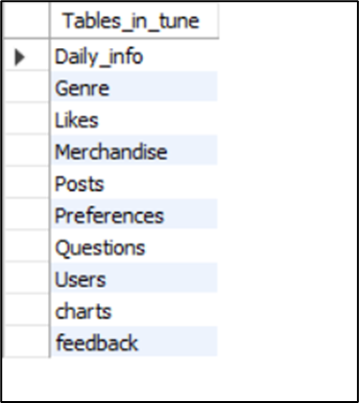
Data Dictionary

Slide 10
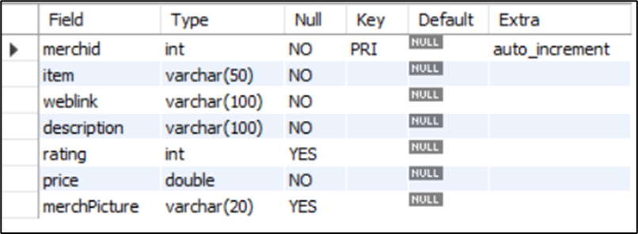
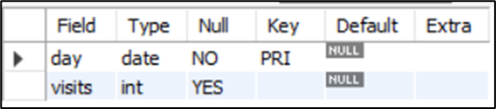
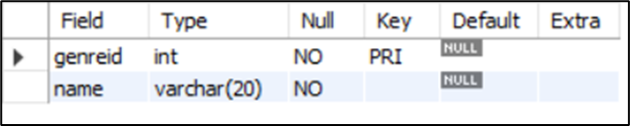
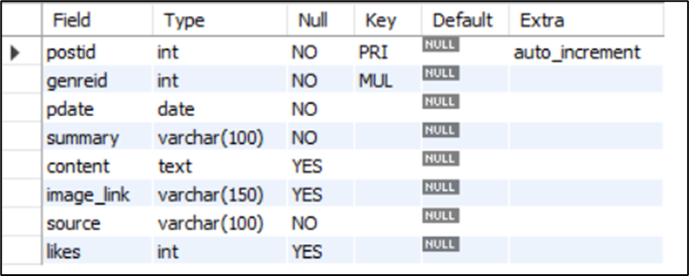
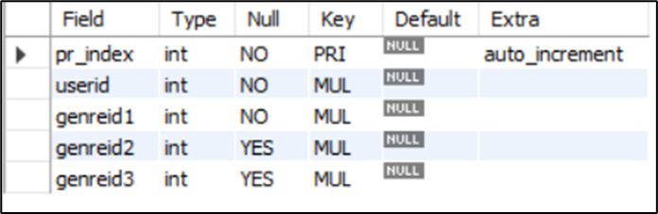
Daily_info
Merchandise
Genre
Posts
Preferences

Slide 11
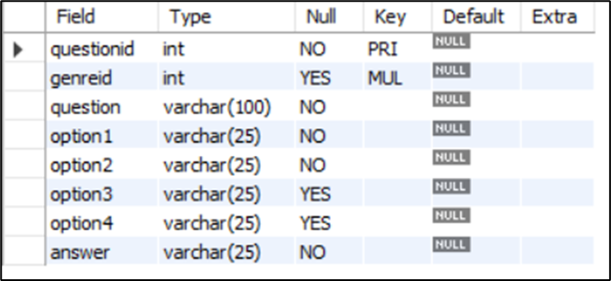
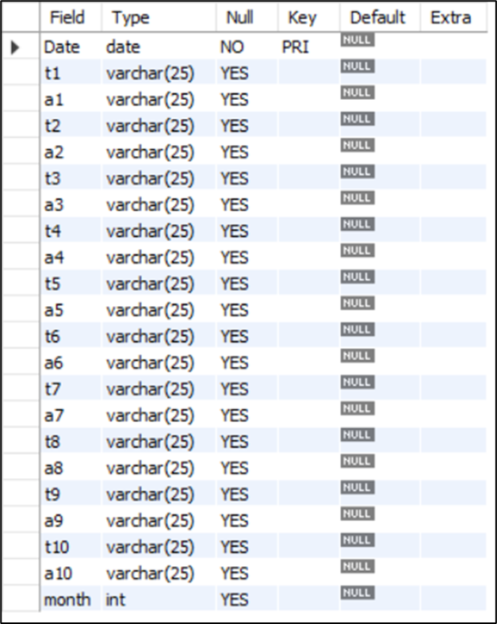
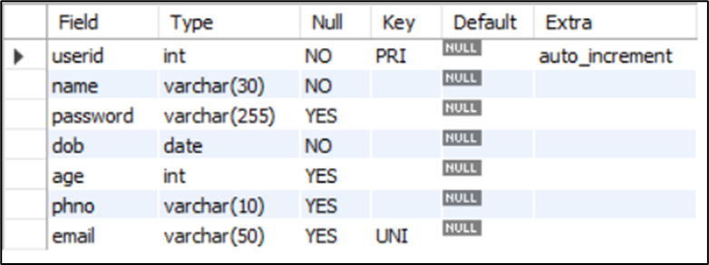
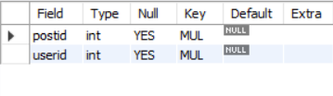
Questions
charts
Users
Likes

Slide 12
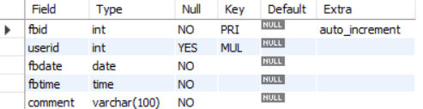
feedback

Slide 13
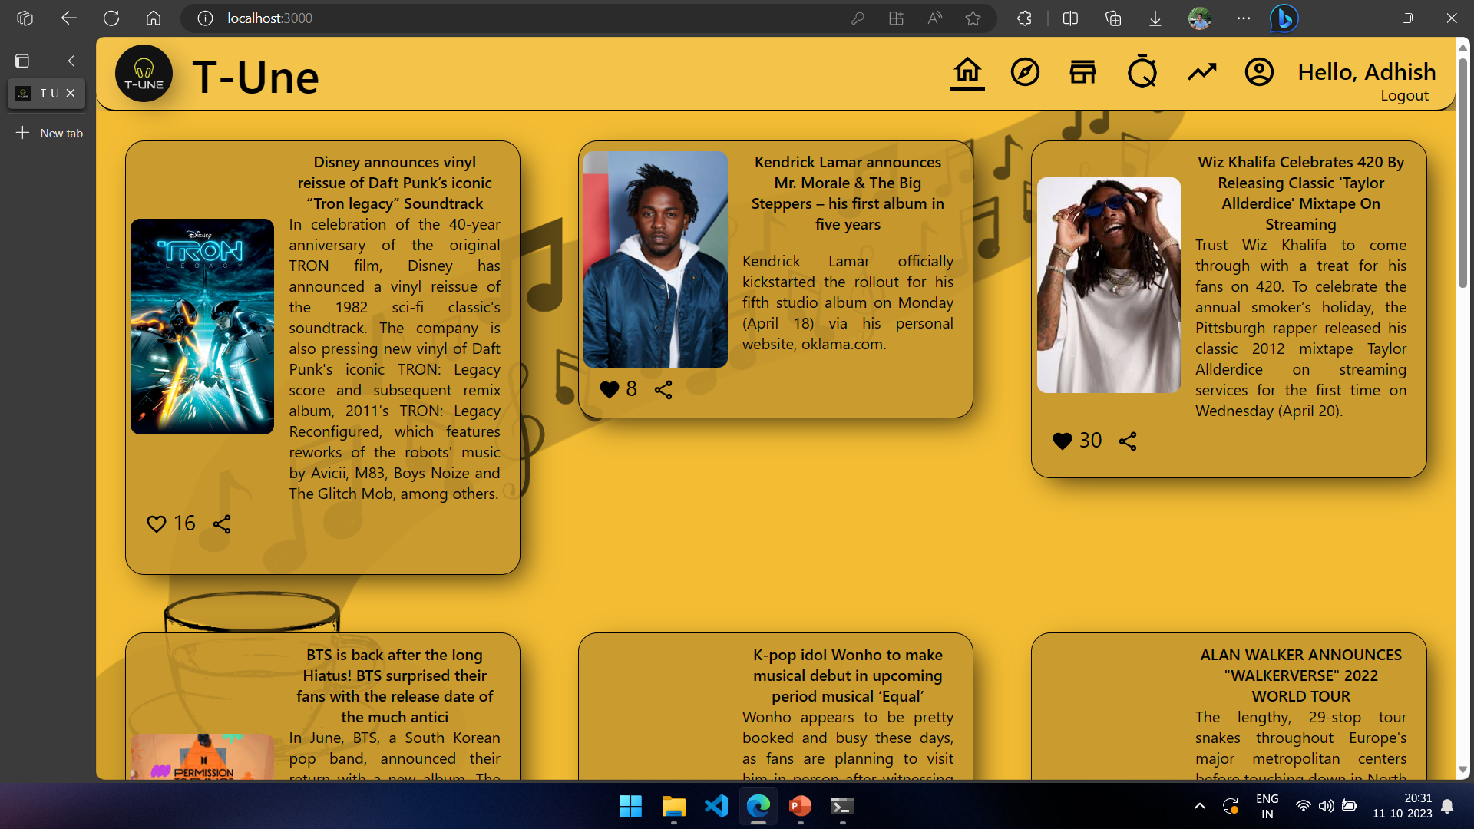
User Interface: HOME PAGE

Slide 14
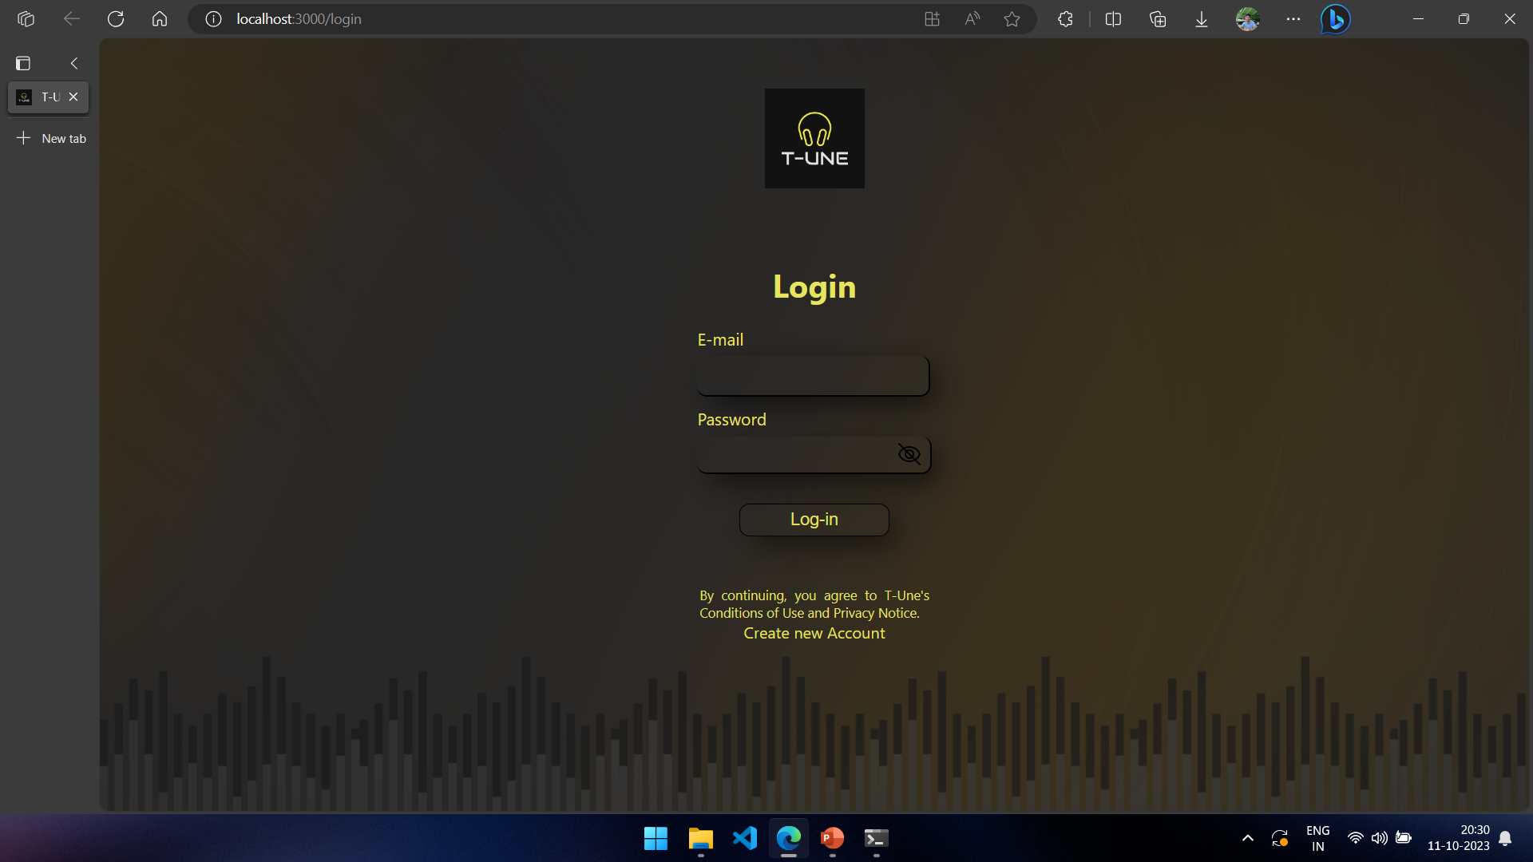
User Interface: LOGIN PAGE

Slide 15
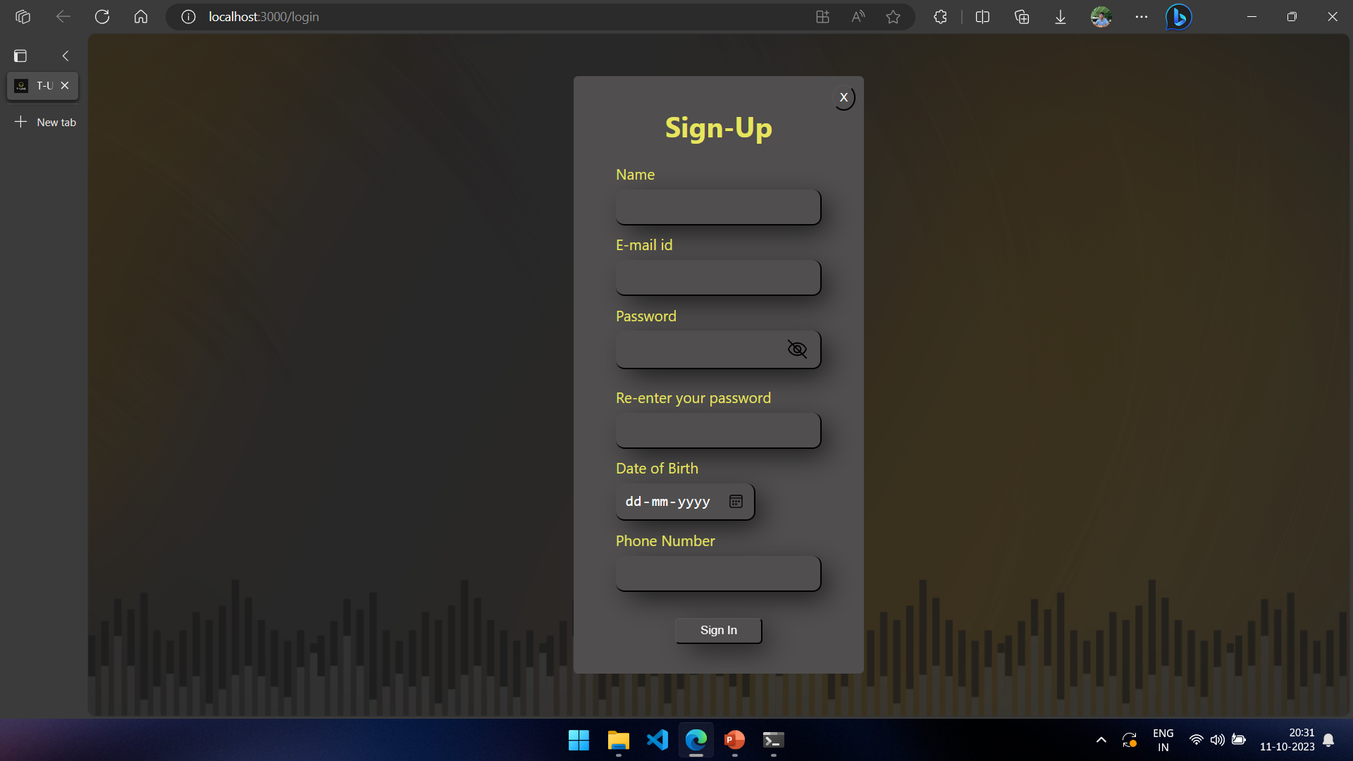
User Interface: SIGNIN PAGE

Slide 16
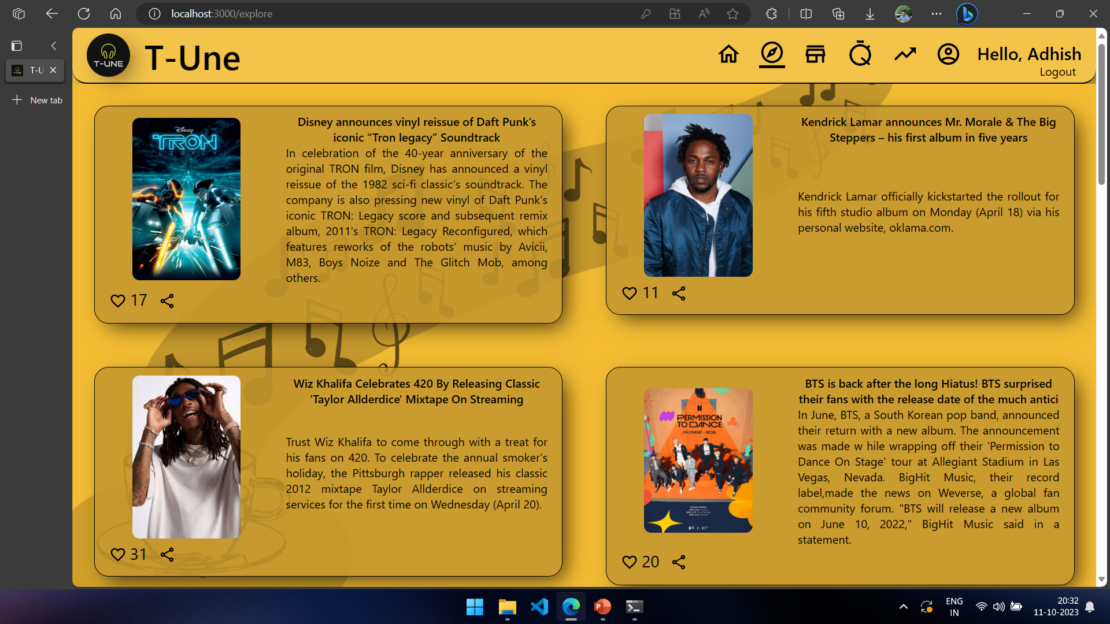
User Interface: EXPLORE PAGE

Slide 17
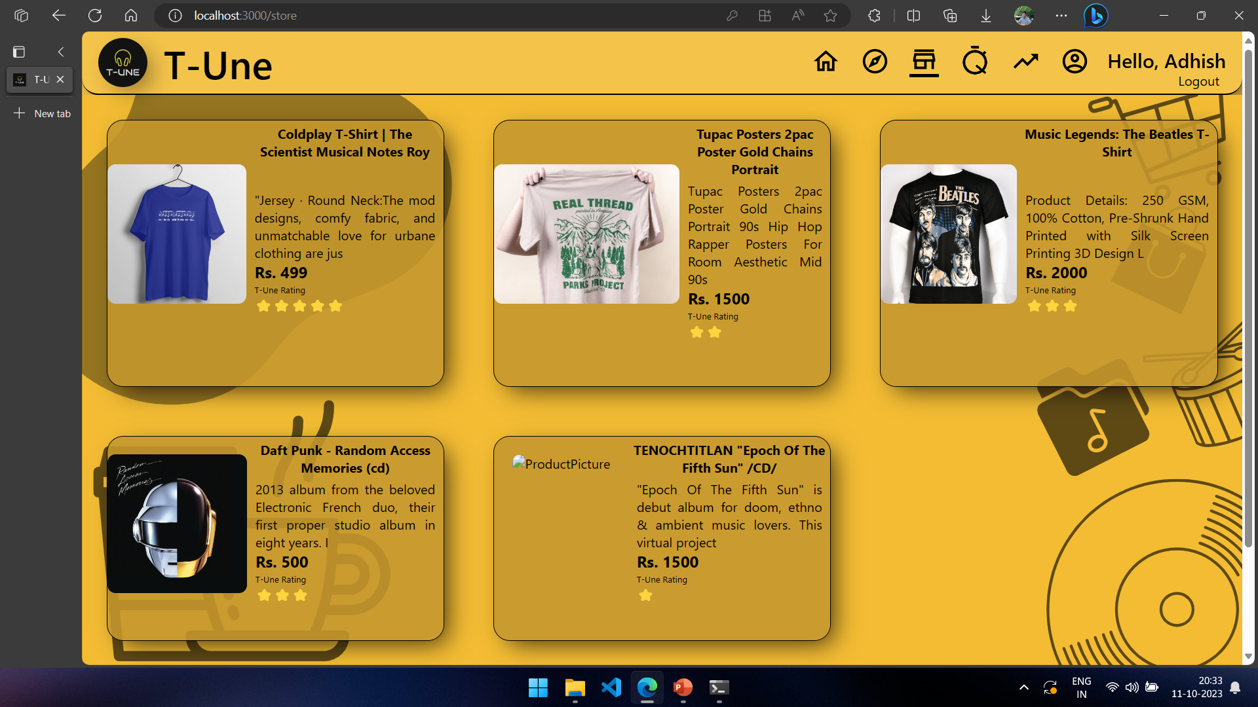
User Interface: SHOPPING PAGE

Slide 18
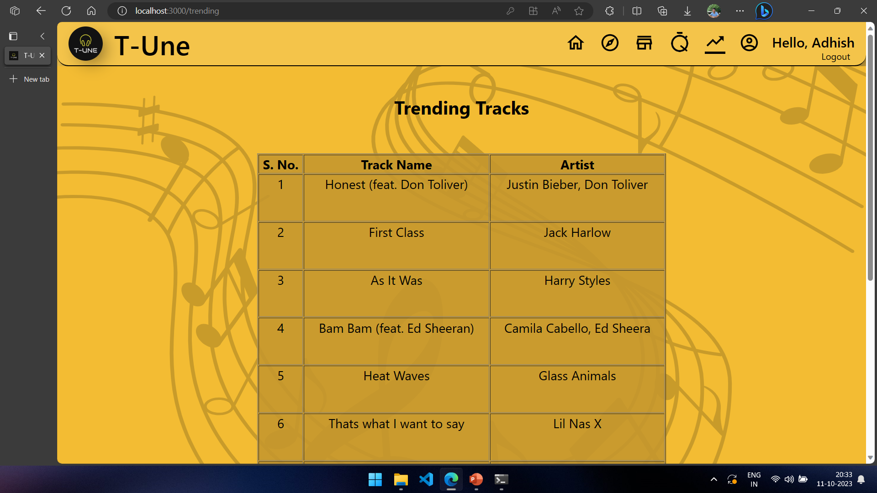
User Interface: TRENDING PAGE

Slide 19
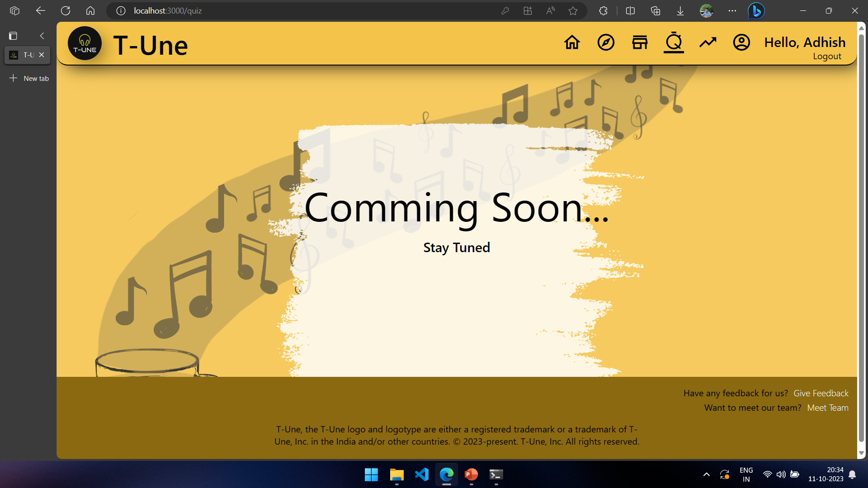
User Interface: QUIZ PAGE

Slide 20
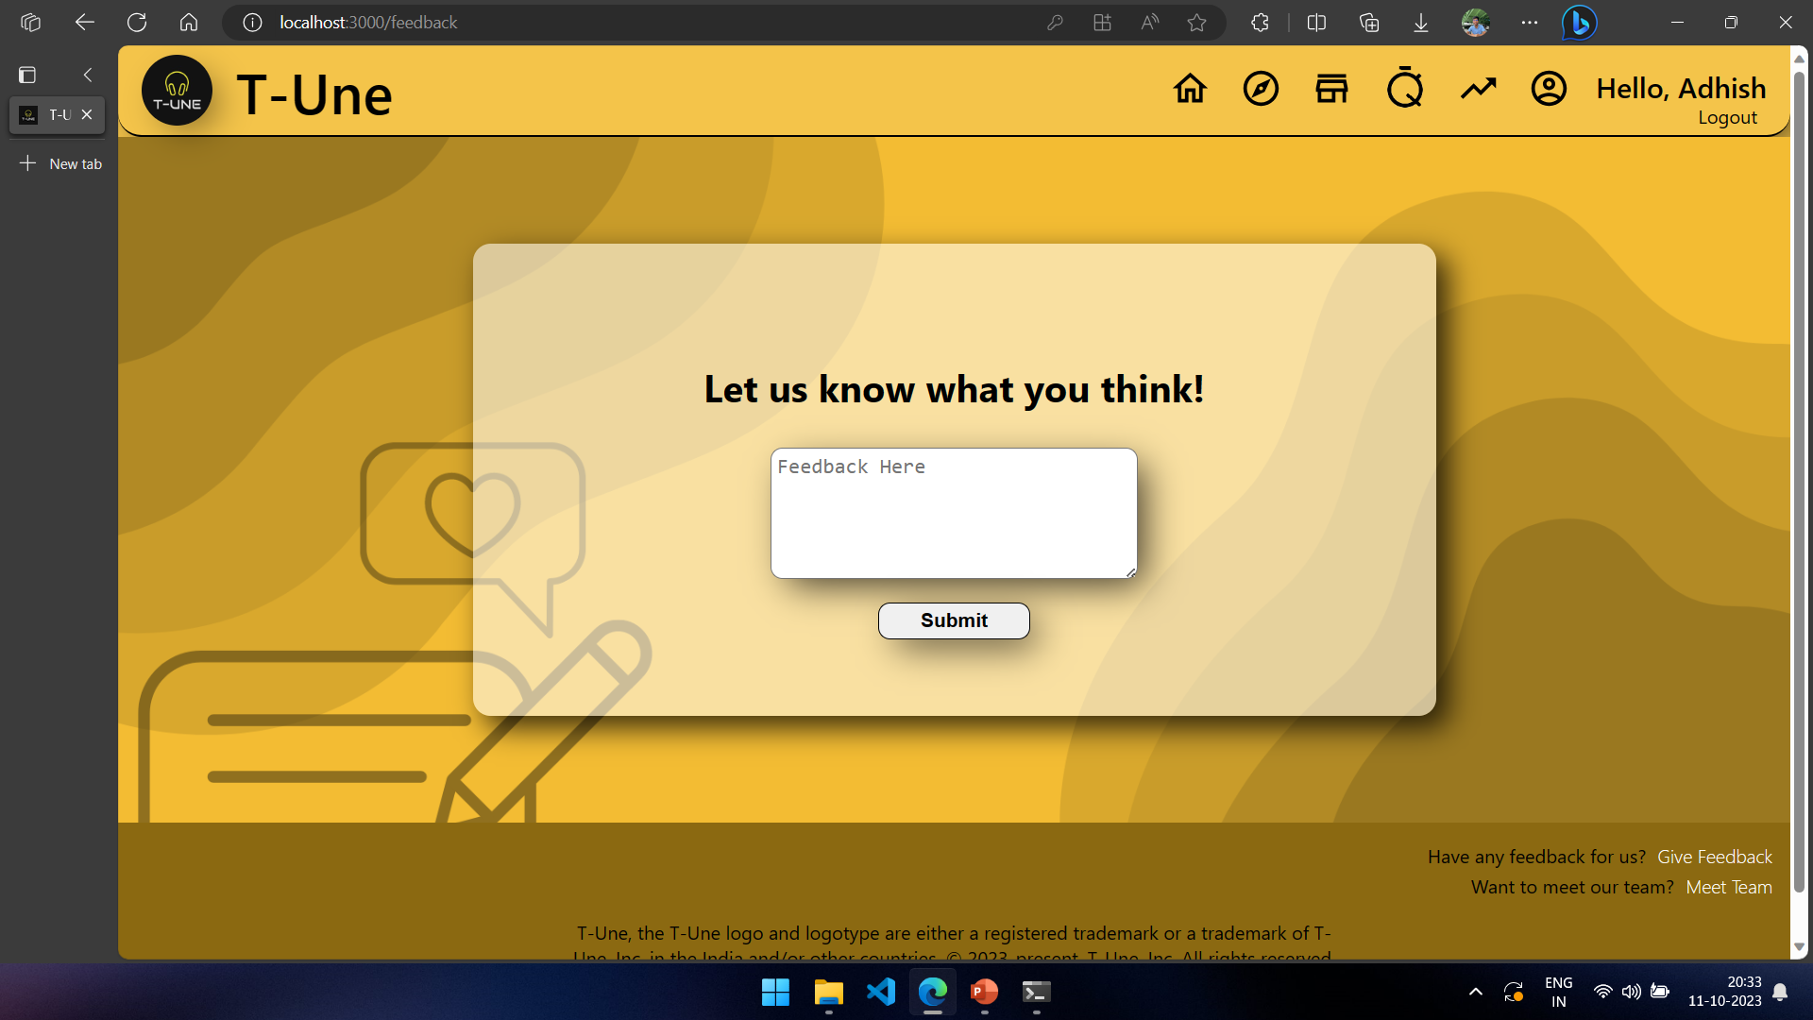
User Interface: FEEDBACK PAGE

Slide 21
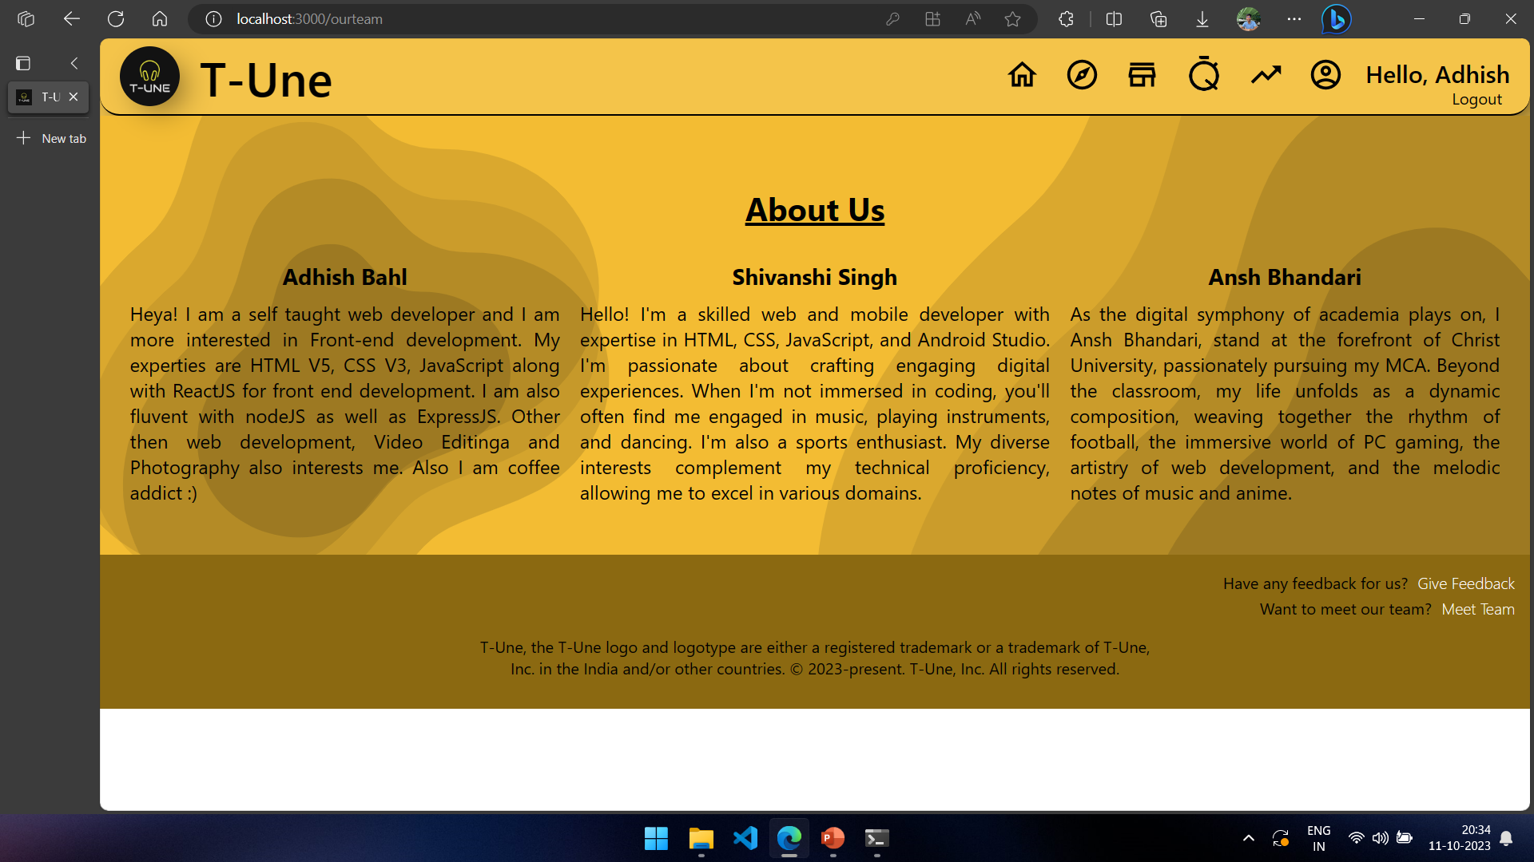
User Interface: ABOUT PAGE

Slide 22


